Slide 1




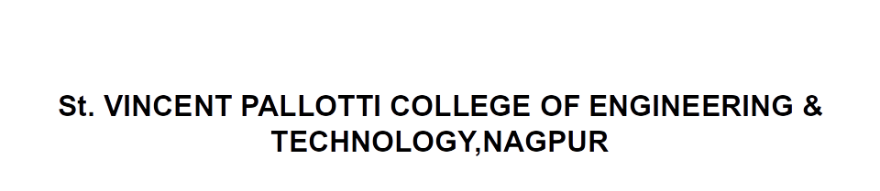
Open Elective –III Transportation System
21CV7610T

Slide 2

Airport Systems
Contents
Components of an airport, Runway length, Runway orientation, Runway and Taxiway marking and lighting, Instrumental Landing System

Slide 3
Introduction
The first power driven plane was flown by the Wright brothers in 1903 at Kitty Hawk, North Carolina, U.S.A.
The early planes were driven by propellers, which were later replaced by turboprops and turbojets.
In 1927, Lindburg made the first solo flight between New York and Paris.
In India, in 1911, Henri Piquet, a Frenchman flew the first flight from Allahabad to Naini.

Slide 4
Introduction…
J.R.D. Tata made a solo flight in 1932 from Karachi to Bombay in a single engine Puss Moth.
In the last century, air transport has made dramatic strides. Whereas the propellers driven planes travelled at speeds of 250-300 km per hour, modern jet aircraft can travel at a speed of 1000 km per hour.
Supersonic aircraft, for example Concord, can fly at a speed of 2300 km per hour which is greater than the speed of sound. Modern jets can carry more than 300 passengers.

Slide 5
Advantages and Disadvantages
Advantages
Speed: The biggest advantage of air transport is its high speed. Speeds of 1000 km per hour are quite common
Encourages Tourism: International and domestic travel by air has encouraged the tourism industry.
Promotion of Business and Trade: High value goods and perishables are transported quickly by air, giving a boost to business.
Accessibility to Remote Areas

Slide 6
Advantages…
Military Use: Air transport is invaluable for the defense of the country. It can transport military personnel and defense equipment quickly.
Relief and Rescue Operations: In times of natural and man-made calamities, air transport can provide relief to effected people and rescue them to safety quickly.
Safety: Air transport is very safe compared to road transport and railways. Modern technology and rigid regulations for licensing of planes and pilots make air travel very safe.

Slide 7
Disadvantages
High Consumption of Liquid Fuel: The only fuel for aircraft now is petroleum crude based aviation petrol. As availability of crude worldwide is shrinking, this is a serious disadvantage.
High Noise Pollution: Persons residing near airports and the path of landing and take-off are subjected to high noise levels.
High Cost: Compared to road transport and rail transport, air travel is very costly and only the rich can avail of it.

Slide 8
Site Selection
Engineering and Physical Factors:
The site should have fairly level area so that the earthwork cost is minimal.
The land required for a small airport is about 20 to 40 hectares, but for large airports it can be as large as 6,000 to 15,000 hectares. This quantity of land has to be acquired.

Slide 9
Site Selection….
The site should permit future expansion.
Airport approaches must be clear of obstructions like tall buildings, towers, hills, and transmission lines.

Slide 10
Site Selection….
The site should permit future expansion.
Airport approaches must be clear of obstructions like tall buildings, towers, hills, and transmission lines.
The site should be easily accessible to all users, such as passengers, industry and business.
The area should be well drained, free from flood and have a low water table.
Bird hits cause serious damages to the aircraft and endanger the safety. The site should, therefore, be away from slaughter houses and refuse dumps that attract birds.

Slide 11
Site Selection….
A good and firm soil can reduce the cost of pavement of runways, taxiways and apron.
The site should not create noise nuisance to residential areas and hospitals.
Services like electricity, water, gas, sewerage and telephone should be easily available.
Good quality construction materials should be available nearby.

Slide 12
Meteorological Factors
Wind velocity, direction, frequency, turbulence and gusts influence aircraft operation and these should be favourable.
Wind direction and velocity influence the orientation of the runway.
Visibility conditions like fog, dust-storms influence safe landing and take-off. These should be favorable.

Slide 13
Airport Layout
Principal Components of Airport
1. Airfield
Runway - the place where the aircraft lands and takes off. It has a strong paved surface with shoulders on either side for serving as safety zones in case an aircraft goes off runway sideways.
Stop ways - are provided at the ends of the runway to accommodate an aircraft that overshoots a runway during landing or has an aborted take-off.

Slide 14
Airfield……
Taxi-way - is a paved strip connecting the runway with the apron or connecting runways with one another.
Apron - is the hard-standing area where aircraft is parked for embarking/disembarking the passengers or where cargo is loaded/ unloaded.
Fueling and catering services are also carried out here. A holding apron (also called a run-up area) is that portion provided near the ends of the runway for aircraft waiting for take-off.

Slide 15
2. Terminal Area
Terminal buildings - are where the passengers are serviced and cargo and mail are handled.
Gates - are the openings in the terminal building where the embarking passengers are allowed to proceed to the aircraft. The transfer of passengers from the gate to the aircraft and vice versa is accomplished by buses or through aerobridges.
Aircraft servicing facilities - include hangars which are covered area intended for repairing and servicing of aircraft.

Slide 16
3. Flight support facilities-
These include structures for air traffic control, navigational aids and fueling the aircraft.

Slide 17
Airport Pavements
Runway and Taxiway dimensions
Airport pavements must meet the following requirements:
They must have adequate strength to withstand the heavy loads imposed by modern aircrafts.
They must take care of the repetition of loads over the design life of the pavement.

Slide 18
Because of the high speeds at which aircrafts land and take-off, the pavement must take care of the interaction of vehicle response and pavement surface. For this purpose, the surface should be sufficiently smooth.
The surface should be anti-skid.
The pavement should be dust free and take care of jet blast.

Slide 19
The maintenance needs of the pavement should be minimal.
The pavement should withstand the detrimental effect caused by fuel and oil spillage.
The cost of the pavement should be economical

Slide 20
Types of Pavements
A bituminous surfaced pavement has a smooth surface and is the preferred choice for runways. For taxiways and aprons where joints in concrete pavement are not a disadvantage and the drippings of oil from the engines do not affect the pavement, a concrete pavement is generally preferred.

Slide 21
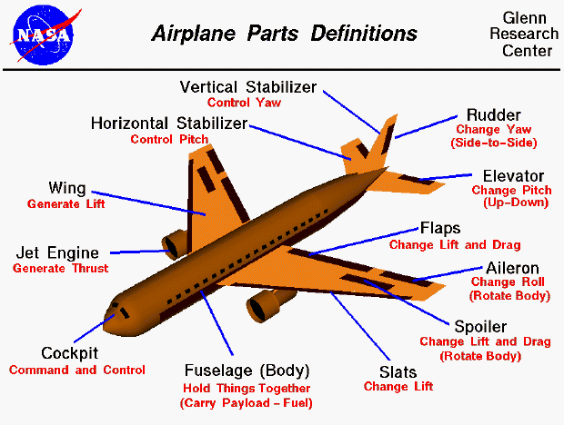
Airplane Components

Slide 22


